Slide 1
Analysis for an information system development project
CMPG213 PROJECT PHASE 3

Slide 2
Table of Contents
Project scope
Use-Case modelling (Business Actors)
Use-Case modelling (Use-case model diagram)
Data model
Process Model

Slide 3
1. Project Scope
The system must include functionality for the following:
Maintenance of stock (inventory)
Maintenance of category (lights, switches)
Maintenance of subcategory (light white, light yellow)
Maintenance of employees
Maintenance of equipment
Maintenance of clients
Maintenance of jobs
Selling of stock
Detailed reporting, including job reports , equipment tracking and Inventory tracking.

Slide 4
2. Use-Case modelling (Business Actors)
Term | Synonym | Description
Administrator | Owner | Responsible for maintenance of employees.
Shop Assistant |  | Responsible for maintaining stock, category, subcategory, sales, equipment and process jobs.
Client |  | Responsible for maintaining it’s client details
Employee |  | Responsible for maintenance of jobs

Slide 5
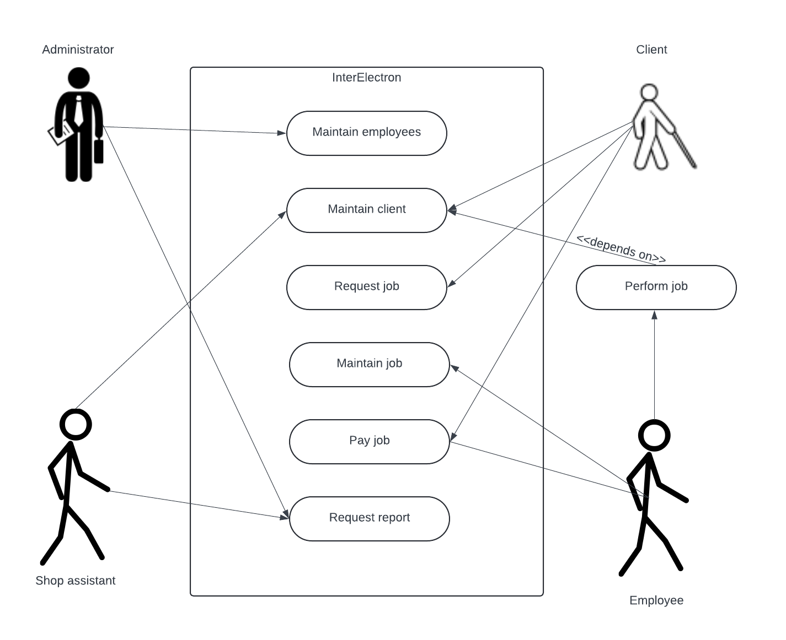
3. Use-Case modelling (Use-case model diagram)

Slide 6
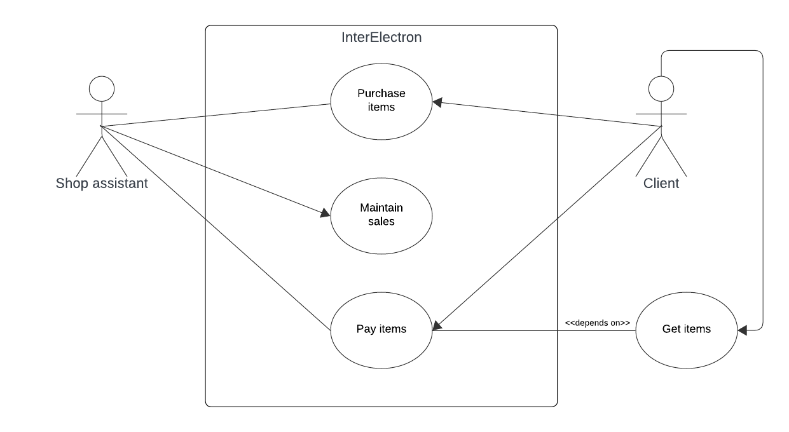
3. Use-Case modelling (Use-case model diagram)

Slide 7
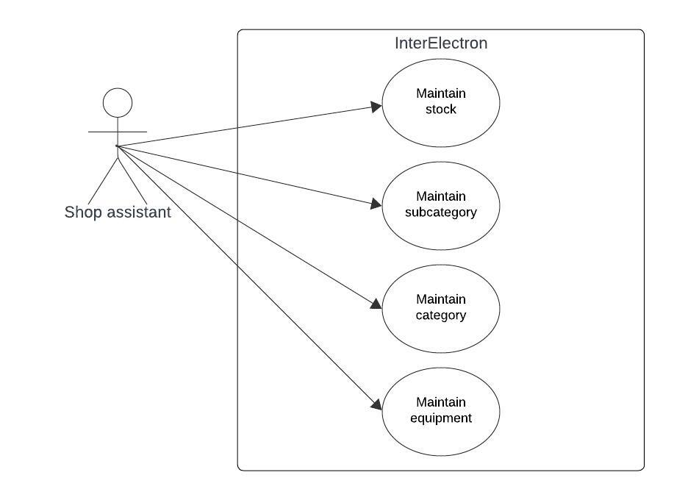
3. Use-Case modelling (Use-case model diagram)

Slide 8
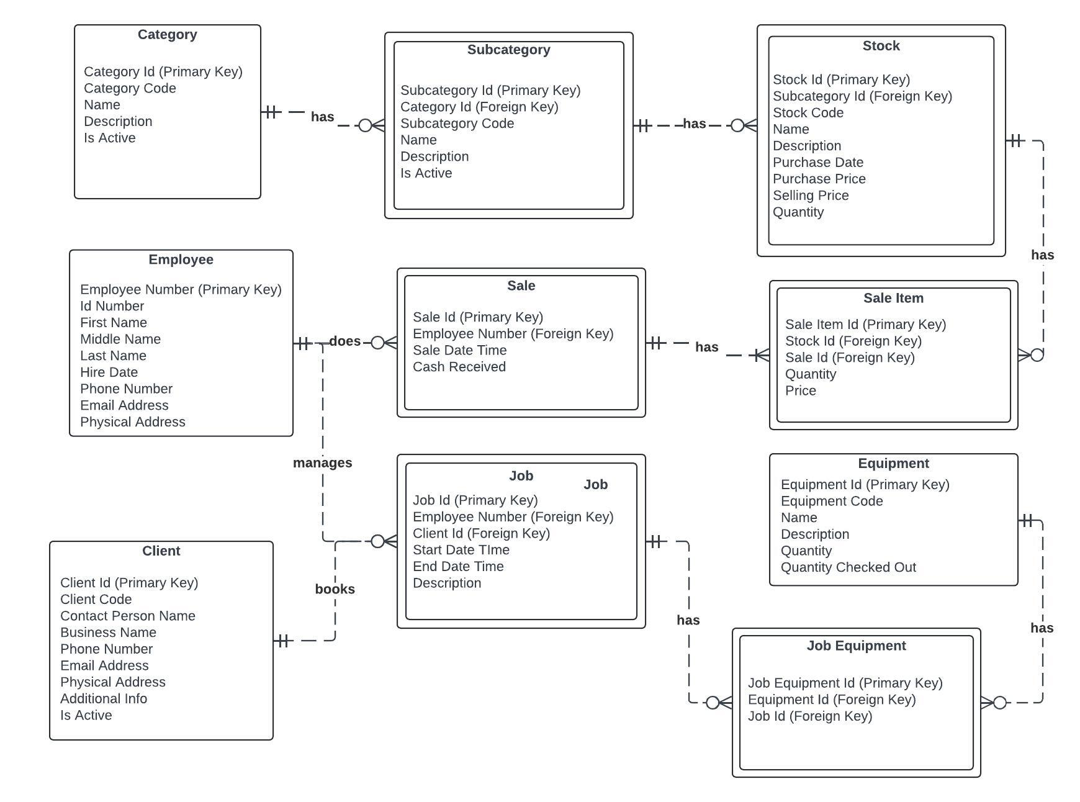
4. Data model

Slide 9
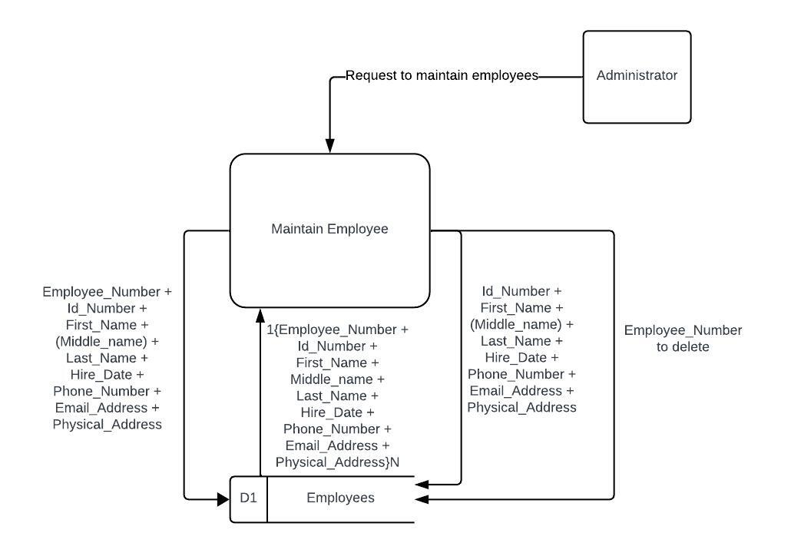
5. Process Model

Slide 10
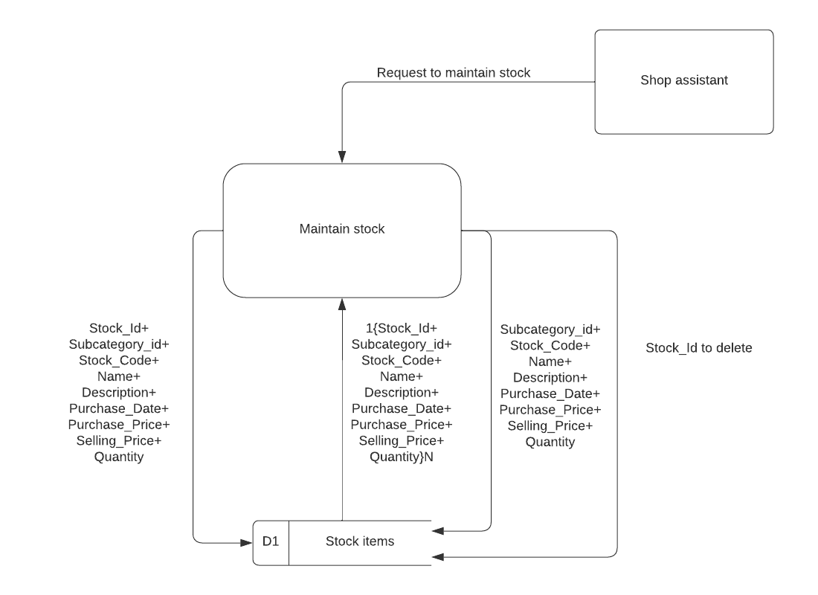
5. Process Model

Slide 11
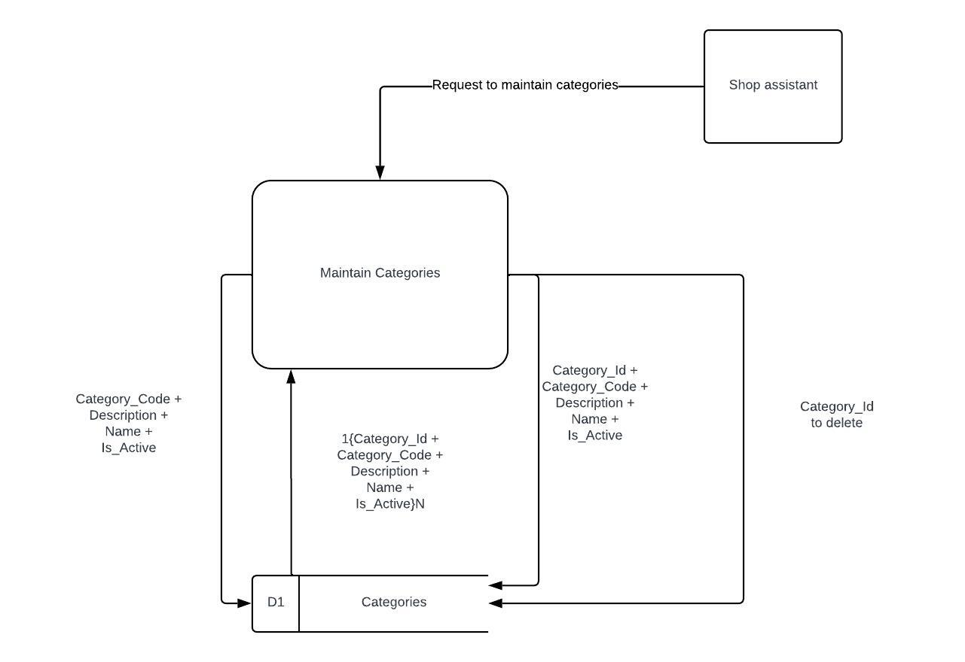
5. Process Model

Slide 12
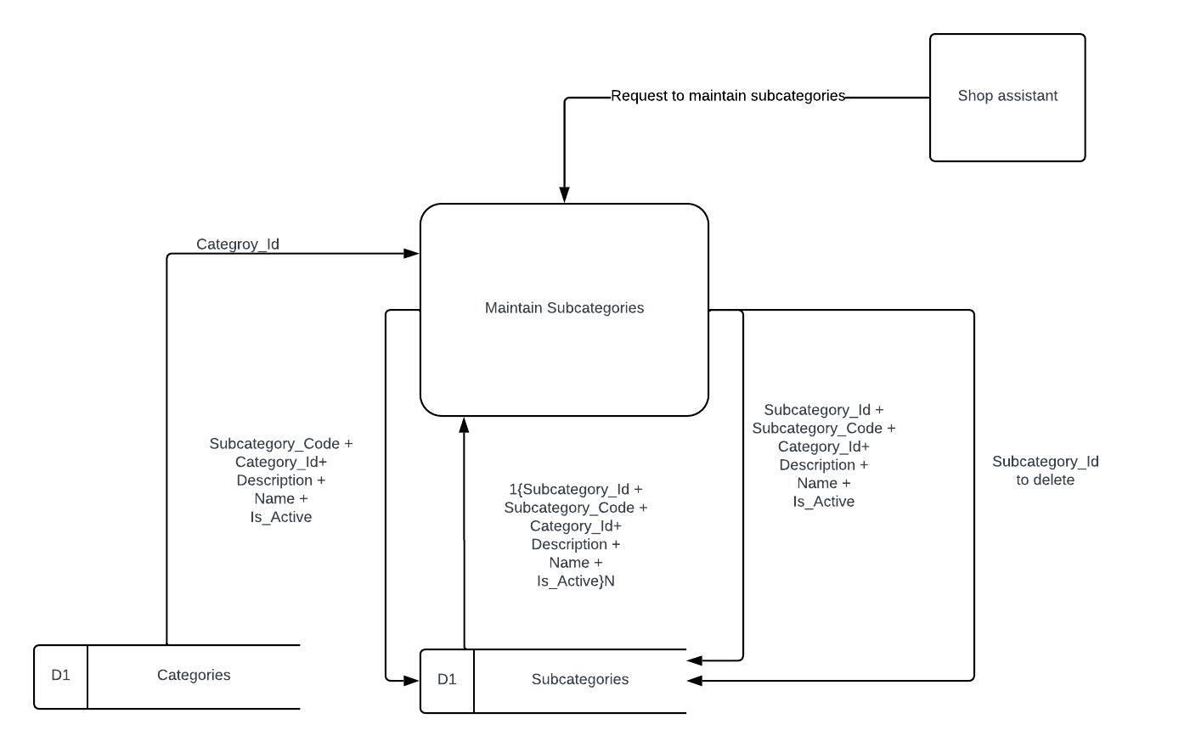
5. PROCESS MODEL

Slide 13
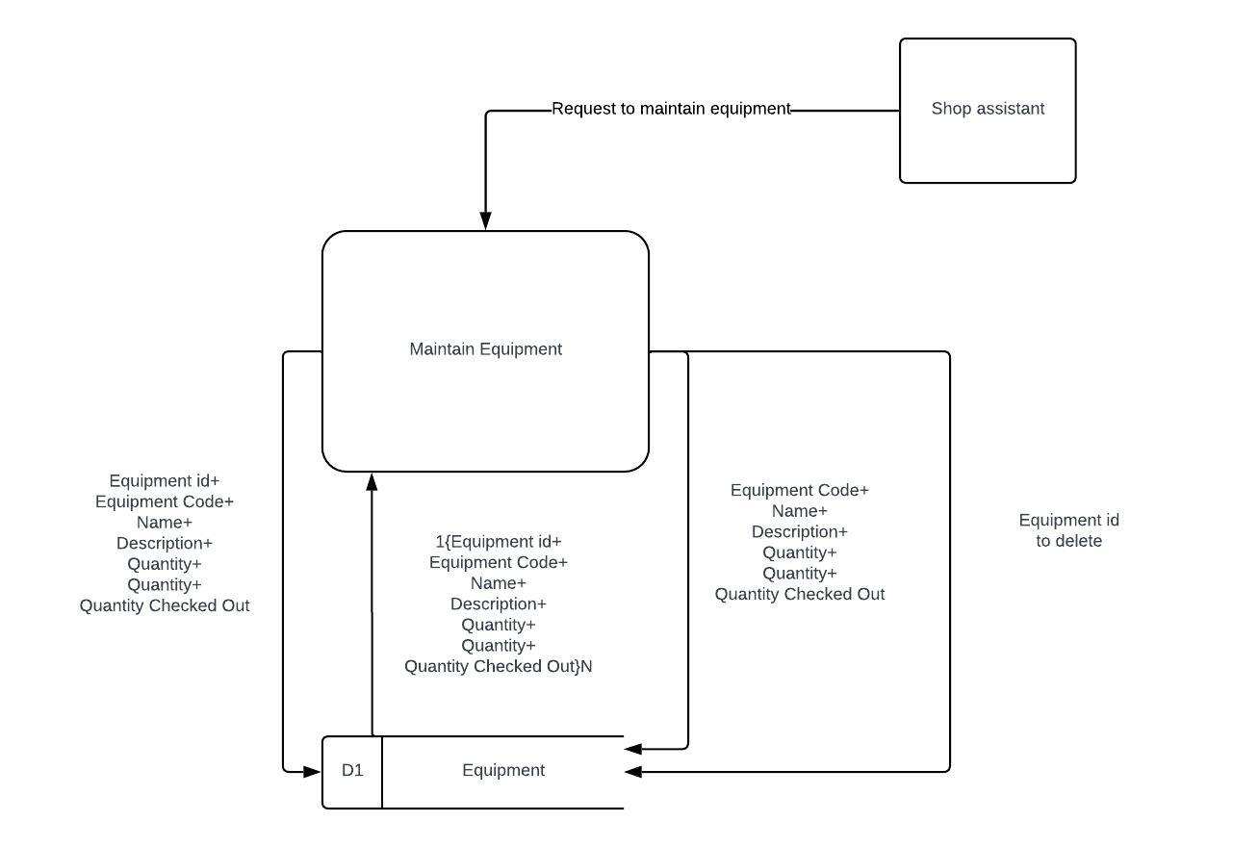
6. PROCESS MODEL

Slide 14
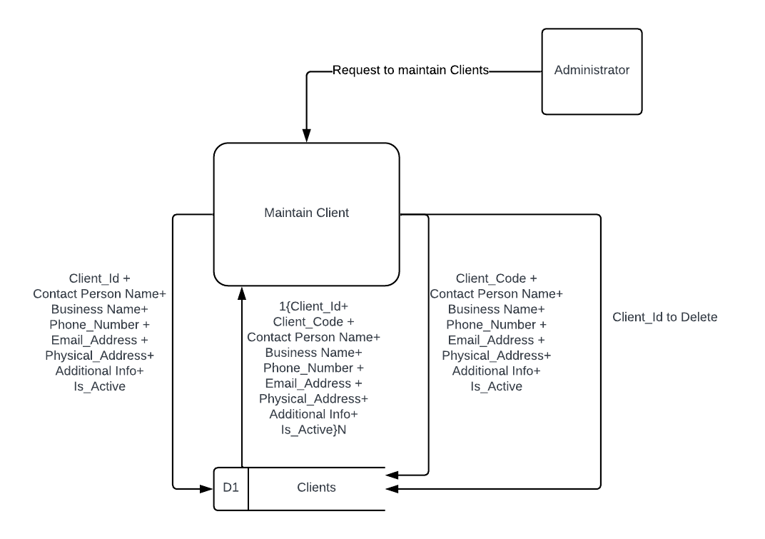
5. Process Model

Slide 15
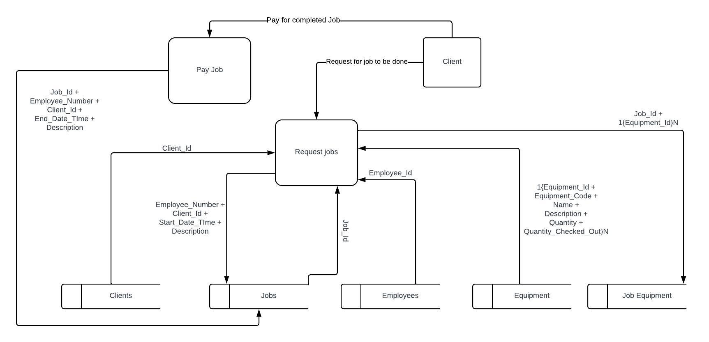
5. Process Model

Slide 16
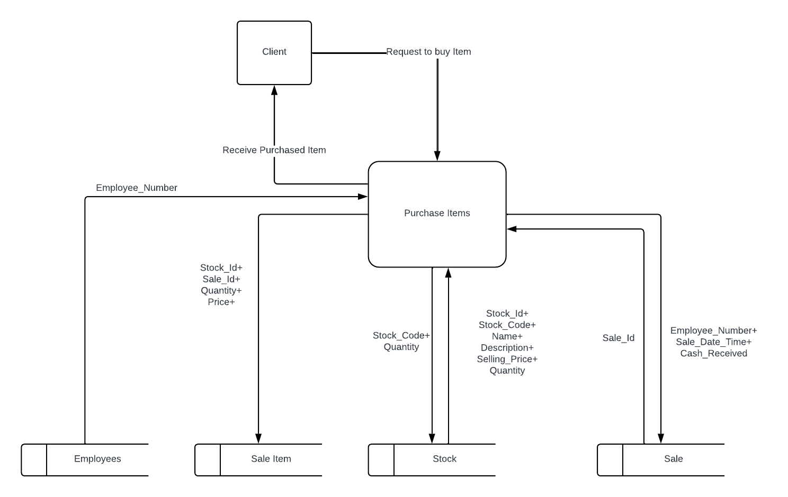
5. Process Model

